Slide 1
One-vs-Rest and One-vs-One for Multi-Class Classification

Slide 2
What you will learn today
Binary classification models like logistic regression and SVM do not support multi-class classification natively and require meta-strategies.
The ‘One-vs-Rest strategy’ splits a multi-class classification into one binary classification problem per class.
The ‘One-vs-One strategy’ splits a multi-class classification into one binary classification problem per each pair of classes.

Slide 3
One-Vs-Rest for Multi-Class Classification
It involves splitting the multi-class dataset into multiple binary classification problems. A binary classifier is then trained on each binary classification problem and predictions are made using the model that is the most confident.
For example, given a multi-class classification problem with examples for each class ‘red,’ ‘blue,’ and ‘green‘. This could be divided into three binary classification datasets as follows:
Binary Classification Problem 1: red vs [blue, green]
Binary Classification Problem 2: blue vs [red, green]
Binary Classification Problem 3: green vs [red, blue]

Slide 4
Downside of One-vs-Rest Meta-strategy
A possible downside of this approach is that it requires one model to be created for each class.
For example, three classes requires three models.
This could be an issue for:
# large datasets (e.g. millions of rows),
# slow models (e.g. neural networks), or
# very large numbers of classes (e.g. hundreds of classes).

Slide 5
One-Vs-One for Multi-Class Classification
One-vs-One (OvO for short) is another heuristic method for using binary classification algorithms for multi-class classification.
Like one-vs-rest, one-vs-one splits a multi-class classification dataset into binary classification problems. Unlike one-vs-rest that splits it into one binary dataset for each class, the one-vs-one approach splits the dataset into one dataset for each class versus every other class.

Slide 6
One-Vs-One Meta-strategy for multi-class classification
For example, consider a multi-class classification problem with four classes: ‘red,’ ‘blue,’ and ‘green,’ ‘yellow.’ This could be divided into six binary classification datasets as follows:
Binary Classification Problem 1: red vs. blue
Binary Classification Problem 2: red vs. green
Binary Classification Problem 3: red vs. yellow
Binary Classification Problem 4: blue vs. green
Binary Classification Problem 5: blue vs. yellow
Binary Classification Problem 6: green vs. yellow

Slide 7
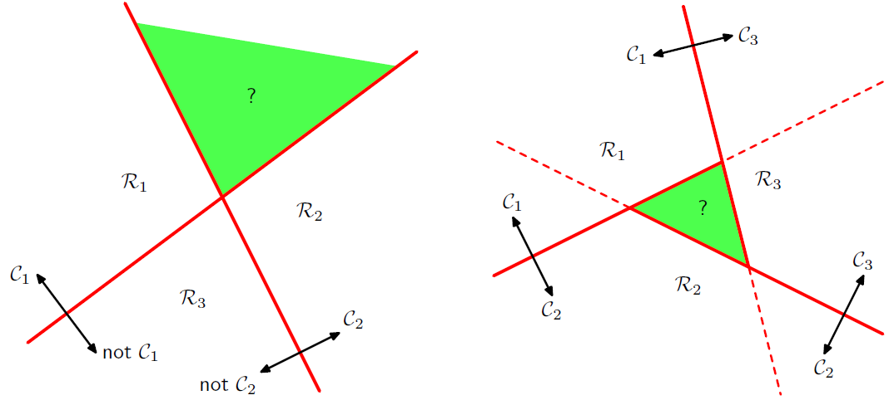
Multiple classes classification
One-versus-the-rest method (green region showing the ambiguity)
One-versus-one method

Slide 8
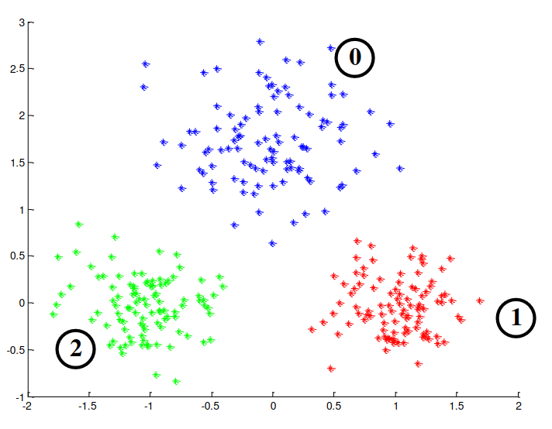
Areas of Ambiguity With These Approaches
Here is a sample dataset:

Slide 9
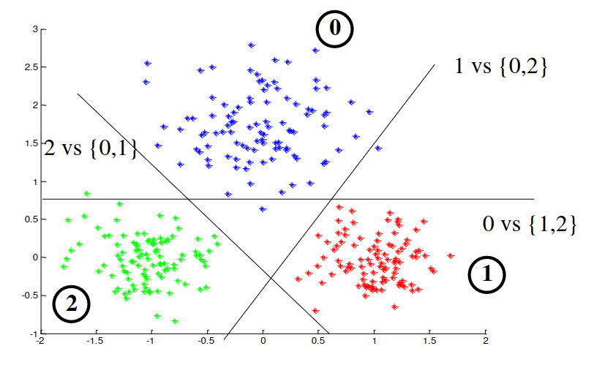
Decision Boundaries For One-Vs-Rest Meta-strategy

Slide 10
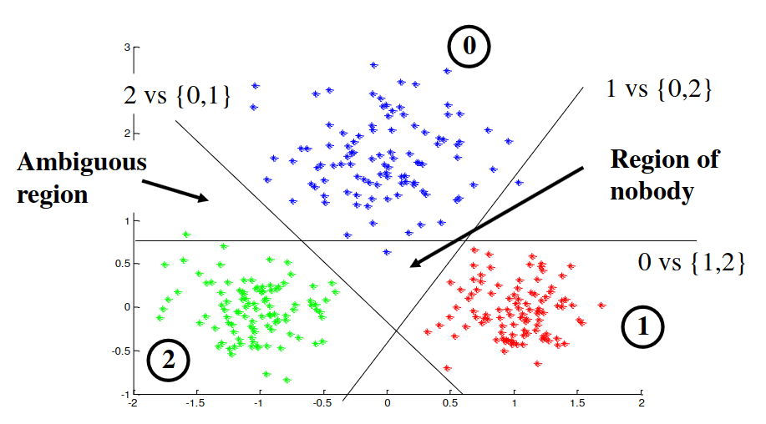
Ambiguous Regions

Slide 11
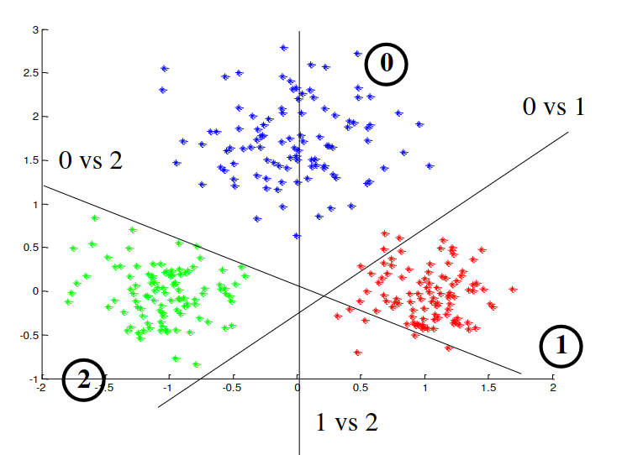
Decision Boundary For One-vs-One Meta-strategy

Slide 12
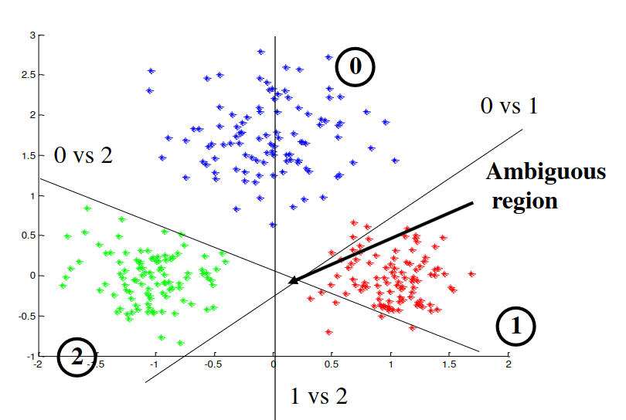
Ambiguous Region in One-Vs-One Solution

